Slide 1

CSE 330 - Cloud Computing
CA4 Project
Team Members
Saai Swetha M K (E0119016)
Niveditha B (E0119019
Kathir Oli K (E0119066)

Slide 2
TITLE:
HEART FAILURE PREDICTION
Care for your heart..

Slide 3
ABSTRACT
DEPLOY A Machine Learning Model in EC2 Instance / SageMake service in AWS.
Cardiovascular diseases (CVDs) are the number 1 cause of death globally. People with cardiovascular disease or who are at high cardiovascular risk (due to the presence of one or more risk factors such as hypertension, diabetes, hyperlipidaemia or already established disease) need early detection and management wherein a machine learning model can be of great help.

Slide 4

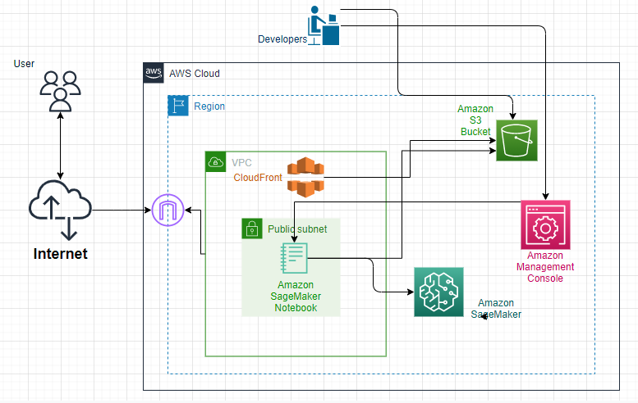


Architecture

Slide 5



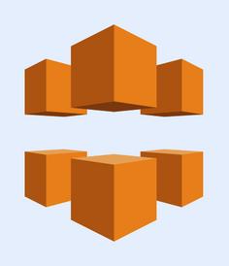
Services Used
Amazon SageMaker
Enables developers to create, train, and deploy machine-learning (ML) models in the cloud
S3
Simple Storage Service is a service that provides object storage through a web service interface.
CloudFront
Web service that delivers content through a worldwide network of data centers called edge locations.

Slide 6
01
02
03
04
05
Collecte Data Analyse it
Workout the Architecture
Create SageMaker Notebook Instance (default VPC, EC2 and IG)
Prepare ML model, Endpoint and S3 Bucket
Prepare CloudFront and host the website
Workflow

Slide 7
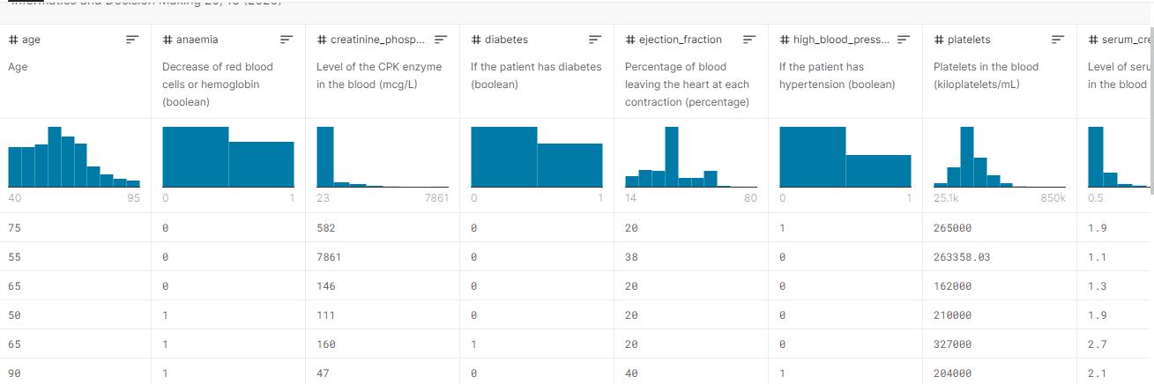
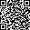
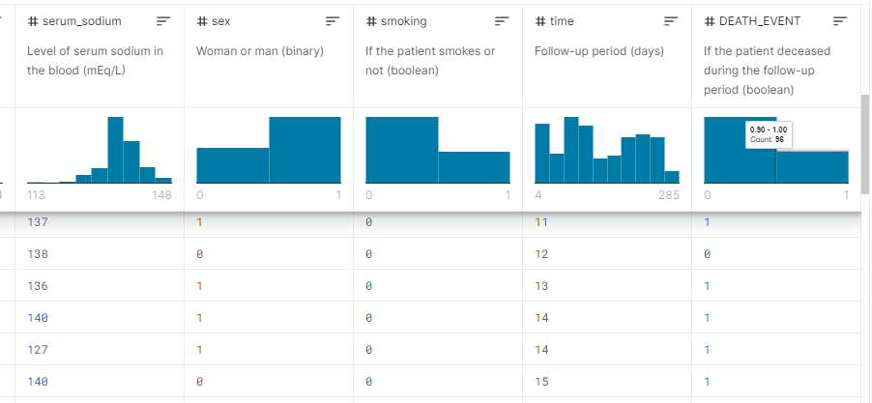
DATASET

Slide 8
ScreenShots
20%
20%
of our work
20%
20%
20%

Slide 9
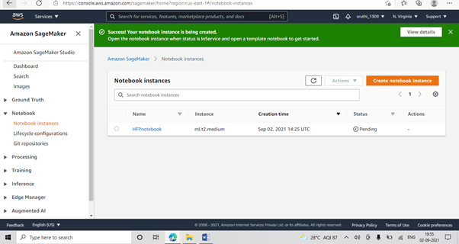
SageMaker Notebook Instance
Item 5
20%
Item 1
20%
Item 4
20%
Item 2
20%
Item 3
20%

Slide 10
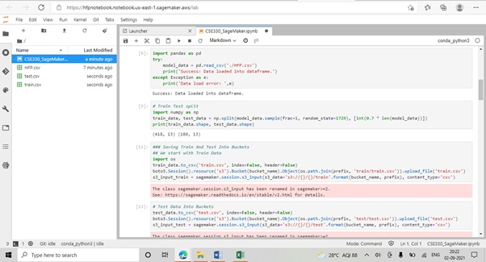
JupyterLab in that notebook Instance
Item 5
20%
Item 1
20%
Item 4
20%
Item 2
20%
Item 3
20%

Slide 11
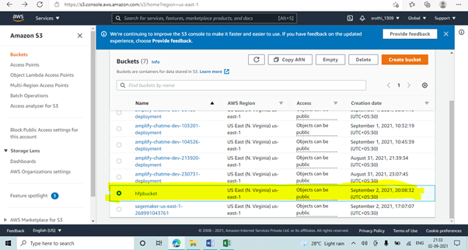
Create S3 using code
Item 5
20%
Item 1
20%
Item 4
20%
Item 2
20%
Item 3
20%

Slide 12
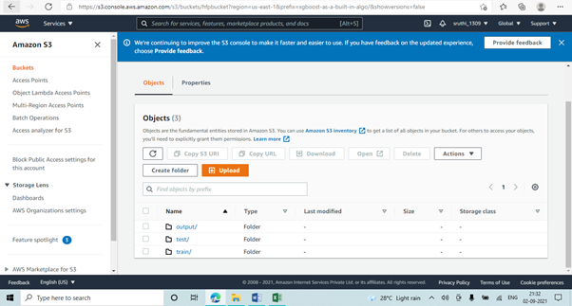
Train, test and output dataset inside S3 Bucket
Item 5
20%
Item 1
20%
Item 4
20%
Item 2
20%
Item 3
20%

Slide 13
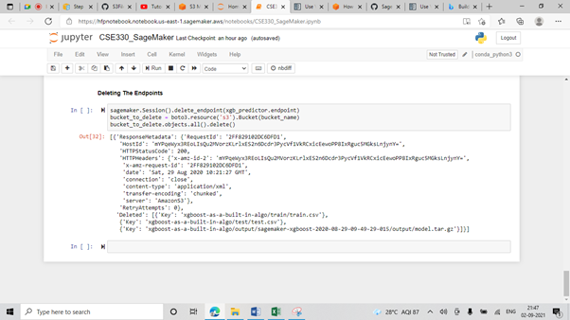
Delete Endpoints, S3 Bucket..
Item 5
20%
Item 1
20%
Item 4
20%
Item 2
20%
Item 3
20%

Slide 14
Our Website

Slide 15

References
Dataset :
https://www.kaggle.com/andrewmvd/heart-failure-clinical-data
SageMaker :
https://aws.amazon.com/getting-started/hands-on/build-train-deploy-machine-learning-model-sagemaker/
Train a ML model in SageMaker :
https://docs.aws.amazon.com/sagemaker/latest/dg/ex1-train-model.html
To Connect SageMaker Notebook Instance to CloudFront:
https://aws.amazon.com/blogs/machine-learning/understanding-amazon-sagemaker-notebook-instance-networking-configurations-and-advanced-routing-options/
To solve errors :
https://github.com/scrapy/scrapy/issues/4641
https://sagemaker.readthedocs.io/en/stable/v2.html
https://github.com/aws/amazon-sagemaker-examples/issues/1774

Slide 16





Thank You

